Slide 1
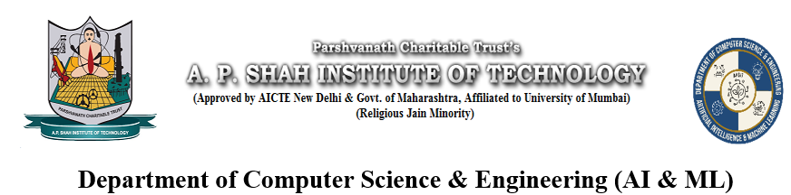
Math-Minds: A Stepwise Solution Generator for Engineering Mathematics Problems using OCR
Kartik Parmar – 22106101
Dhruv Wesavkar–22106016
Niraj Patel-22106050
Rohan Patil –22106044
Project Guide
Prof. Vijaya Bharathi Jagan

Slide 2
Introduction
Engineering students in first and second years often face difficulties in understanding complex mathematical concepts.
Subjects like Laplace Transforms, Linear Programming, Fourier Series, Z-Transforms, and Probability form the core of the Mumbai University M1–M4 syllabus.
Existing learning platforms offer isolated solutions with minimal explanations, leading to confusion and time loss.
Our project aims to build a centralized, AI-powered platform that:
Provides step-by-step problem solving using symbolic computation.
Accepts image and NLP-based inputs for ease of use.
Includes an interactive chatbot for real-time doubt clarification.
This platform will serve as a smart academic assistant, improving understanding, accessibility, and learning efficiency.

Slide 3
Objectives
To develop a centralized web platform that covers the entire M1 to M4 engineering mathematics syllabus.
To provide step-by-step solutions for both symbolic and numerical problems.
To support manual input as well as image-based input using OCR and natural language processing (NLP).
To implement a chatbot assistant that helps explain individual steps and concepts to students in real-time.

Slide 4
Literature Survey
Paper Title | Abstract | Findings | Method | Future Scope
SOLVE IT (MATH SOLVER) | Presents a math-solving application that handles equations, algebra, and basic calculus through computational algorithms. | Demonstrated effectiveness in solving standard mathematical problems and helping students learn step-by-step. | Combination of OCR (for input), symbolic solvers, and predefined algorithms for algebra and calculus. | Extend capability to handle complex engineering-level math and enhance OCR for handwritten problems.
SymPy: Symbolic Computing in Python | Introduces SymPy, an open-source Python library for symbolic mathematics, capable of handling algebra, calculus, number theory, and more. | Found to be a lightweight yet powerful tool widely adopted for research, teaching, and prototyping. | Python-based symbolic computation, modular design, algorithms for simplification, equation solving, differentiation, and integration. | Improve performance for large-scale problems, expand coverage of advanced domains, and enhance integration with machine learning.
Effectiveness of Intelligent Tutoring Systems: A Meta-Analytic Review | Reviews multiple studies on the effectiveness of Intelligent Tutoring Systems (ITS) in education. | ITS improves student learning outcomes significantly compared to traditional methods; benefits noted in personalized learning. | Meta-analysis of existing research studies and experiments involving ITS. | Wider adoption in classrooms, integration with AI for adaptability, and extending ITS to diverse subjects.

Slide 5
Paper Title | Abstract | Findings | Method | Future Scope
Advancing Education through Tutoring Systems: A Systematic Literature Review | Provides a systematic review of recent work on tutoring systems, analyzing advancements and challenges. | Identifies trends in adaptive learning, AI integration, and limitations like lack of personalization and domain specificity. | Literature review methodology across various tutoring system studies. | Development of more adaptive, domain-specific, and scalable intelligent tutoring systems.
An Expression Tree Decoding Strategy for Mathematical Equation Generation | Proposes a novel decoding strategy using expression trees for generating mathematical equations from natural language problems. | Expression tree strategy improves accuracy and structure in equation generation compared to sequence-only models. | NLP techniques, expression tree-based decoding, tested on benchmark datasets like Math23K. | Extend to multilingual problem solving, enhance handling of complex equations, and integrate into tutoring/solver systems.
A Convolutional Sequence Network for Mathematical Expression Recognition. | Deep learning model that converts math expression images into LaTeX using convolutional encoder–decoder with attention. | Outperforms older models (WAP, WYGIWYS) on IM2LATEX-100K with higher accuracy and faster inference. | CNN encoder (ResNet-based), convolutional decoder (instead of LSTM), multi-layer attention, IM2LATEX-100K dataset. | Extend to handwritten equations, handle complex layouts (matrices, multi-line), apply to other image-to-markup tasks.
Introduction to Mathematical Language Processing | Defines Mathematical Language Processing (MLP) as applying NLP methods to parse, understand, and reason over mathematical expressions. | Existing NLP/AI struggle with math-specific syntax and structure; need for combining symbolic and semantic approaches. | Framework + survey of parsing methods, equation encoders, symbolic tools, and datasets. | Stronger handwritten/complex math recognition, integration of solvers with LLMs, standardized datasets, and educational tutoring applications.

Slide 6
Limitations of Existing Systems
Existing tools like (Wolfram, Sympy, SOLVE IT) are more for a generic use, which are not tailored towards Engineering students.
OCR has low accuracy for handwritten and complex mathematics.
There is a lack of integration between the solver, learning material and tutoring.
Existing tools have not generally give a direct solution, while not showcasing how it reached the final result.

Slide 7
Problem statement
Many first- and second-year engineering students face difficulties solving core math problems from M1 to M4. Existing online tools are scattered, topic-specific, and provide only final answers without explanations. They also lack interactive features like image/NLP input and chatbot-based doubt clarification, making learning incomplete and less engaging.

Slide 8
Novelty
Complete Syllabus Coverage (M1–M4):
Unlike most tools that cover only a few topics, this platform is designed to
cover the entire engineering math curriculum of MU in one place.
Step-by-Step Symbolic Logic:
Provides detailed, human-readable step-by-step solutions using symbolic
computation—not just final answers.
Image-Based Input: Allows students to upload textbook questions or handwritten problems using
OCR (Optical Character Recognition)
Natural Language Processing (NLP): Students can input questions in plain English (e.g., "Find Laplace transform
of e^(-2t)sin3t") no need to know syntax.
Doubt-Solving Chatbot: A built-in AI assistant explains steps, answers questions, and suggests
alternate methods or links to theory.

Slide 9
System Overview
A web-based platform designed to help engineering students master core
Mathematics subjects (M1–M4).
Homepage features four tabs — each representing a semester’s syllabus.
Clicking on a tab opens topic-wise modules such as:
Complex Numbers
Matrices
Numerical Methods, etc.
Each module includes an interactive solver that:
Accepts mathematical inputs.
Provides step-by-step solutions.
Offers a downloadable or expandable formula sheet for quick reference.
A user-friendly interface ensures structured input, maintaining clarity and accuracy.
Integrates computation and conceptual understanding within a
single centralized platform to enhance learning.

Slide 10
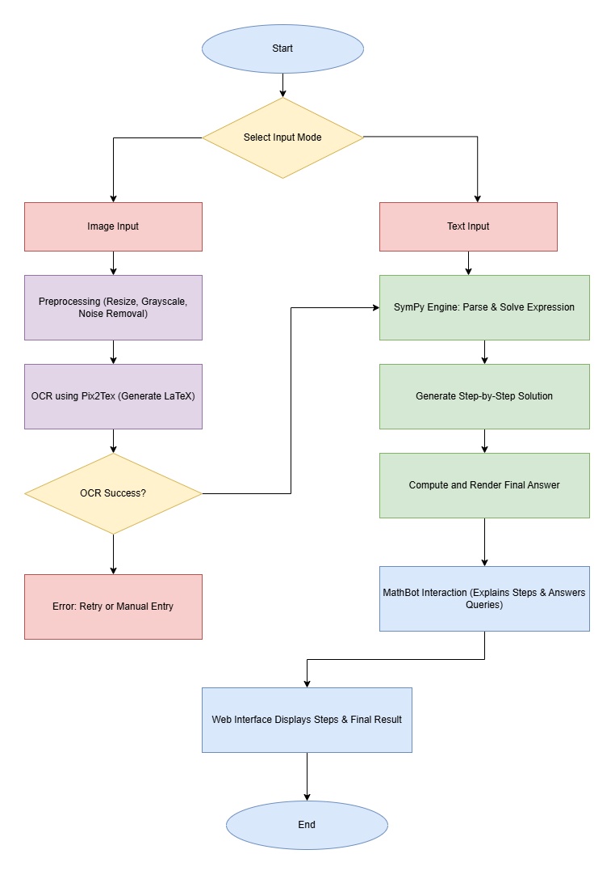
WorkFlow of System

Slide 11
Tech Stack Used
Frontend
HTML5 / CSS3 – Structure & styling
JavaScript – Dynamic behavior
Tailwind CSS – Responsive UI
MathJax -To render mathematical equations beautifully
Backend
Python – Core language for logic and mathematical solving
Flask – Lightweight backend framework to serve APIs and web pages
SymPy – For symbolic mathematics, algebraic manipulations, step-by-step solving
NumPy / SciPy – For numerical computation
OpenCV + PaddleOCR – For reading and extracting math expressions from images
Pix2Tex– Converts mathematical equations into LaTex format.

Slide 12
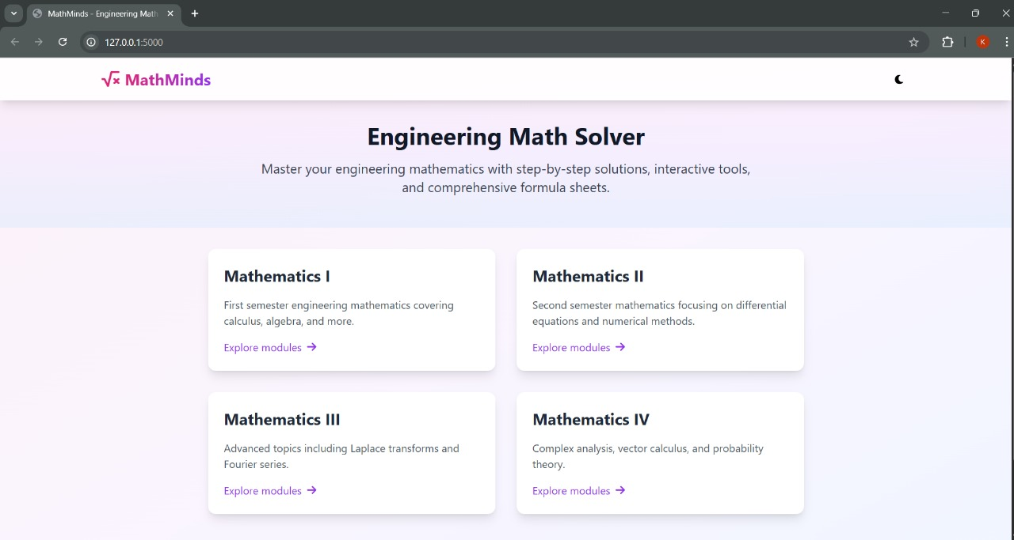
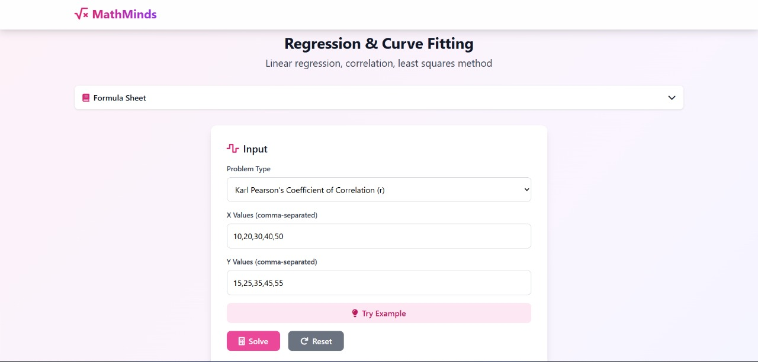
Implementation

Slide 13
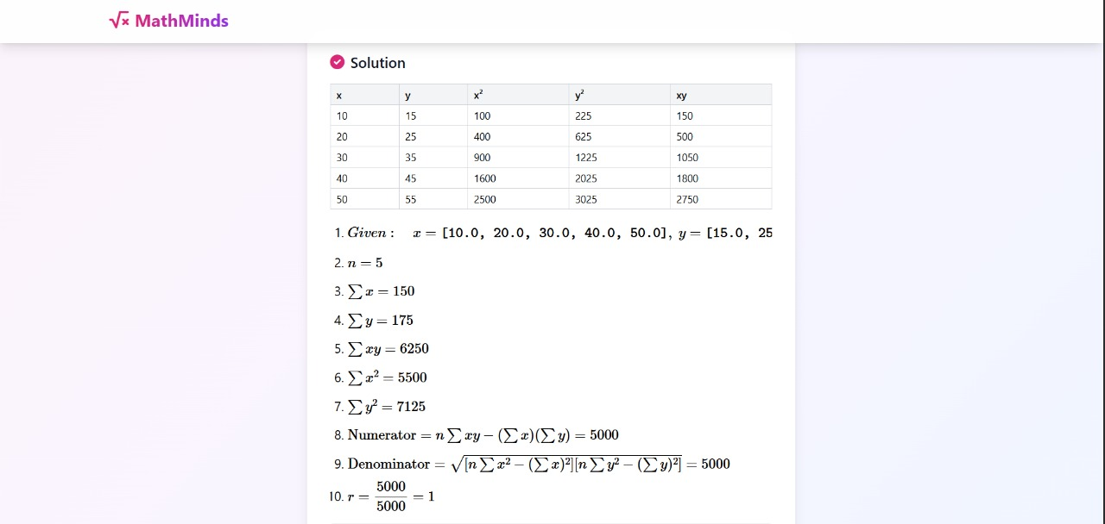
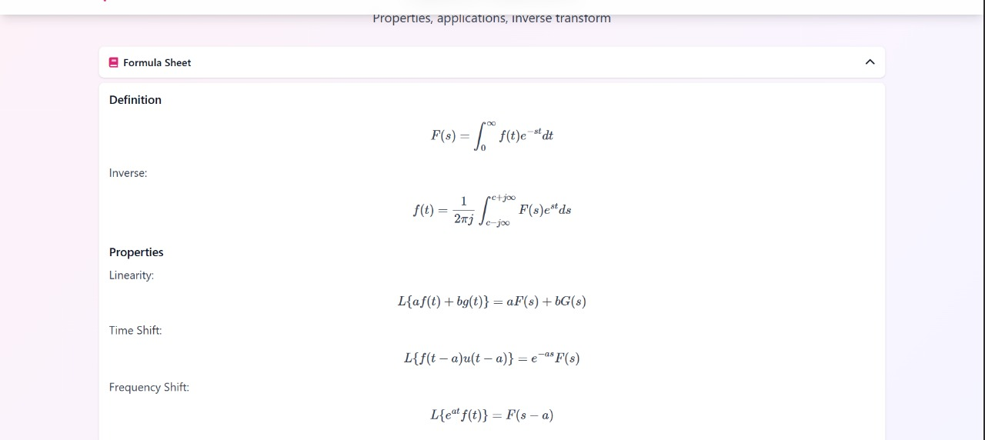

Slide 14
Goals
SDE4: Quality Education
Promotes accessible, high-quality learning tools for engineering students.
SDE9: Industry, Innovation, and Infrastructure
Builds an innovative digital learning platform using AI, NLP, and symbolic computation.
Encourages the integration of technology in education to modernize the learning process.
Enhances conceptual understanding through step-by-step solutions and chatbot

Slide 15
References
[1] Amal Vijay G. , Rosilin R, Gunanidhi D., Sobana K. S. and Mrs. R. Umamageshwari. (2025). SOLVE IT (MATH SOLVER). International Journal of Research in Engineering & Science ISSN:(P) 2572-4274 (O) 2572-4304, 9(2), 1–7.
[2] Vincent Liu, Ehsan Latif, and Xiaoming Zhai. (2025). Advancing Education through Tutoring Systems: A Systematic Literature Review.
[3] Wenqi Zhang, Yongliang Shen, Qingpeng Nong, Zeqi Tan, Yanna Ma, and Weiming Lu. 2023. An Expression Tree Decoding Strategy for Mathematical Equation Generation. In Proceedings of the 2023 Conference on Empirical Methods in Natural Language Processing, pages 439–456, Singapore. Association for Computational Linguistics.
[4] Jordan Meadows, André Freitas; Introduction to Mathematical Language Processing: Informal Proofs, Word Problems, and Supporting Tasks. Transactions of the Association for Computational Linguistics 2023; 11 1162–1184.
[5] Zuoyu Yan, Xiaode Zhang, Liangcai Gao, Ke Yuan and Zhi Tang.(2020). ConvMath: A Convolutional Sequence Network for Mathematical Expression Recognition.

Slide 16
References
[6] Meurer A, Smith CP, Paprocki M, Čertík O, Kirpichev SB, Rocklin M, Kumar A, Ivanov S, Moore JK, Singh S, Rathnayake T, Vig S, Granger BE, Muller RP, Bonazzi F, Gupta H, Vats S, Johansson F, Pedregosa F, Curry MJ, Terrel AR, Roučka Š, Saboo A, Fernando I, Kulal S, Cimrman R, Scopatz A. 2017. SymPy: symbolic computing in Python.
[7] Kulik, J. A., & Fletcher, J. D. (2016). Effectiveness of Intelligent Tutoring Systems: A Meta-Analytic Review. Review of Educational Research, 86(1), 42-78.

Slide 17
Thank You...!!

